Slide 1
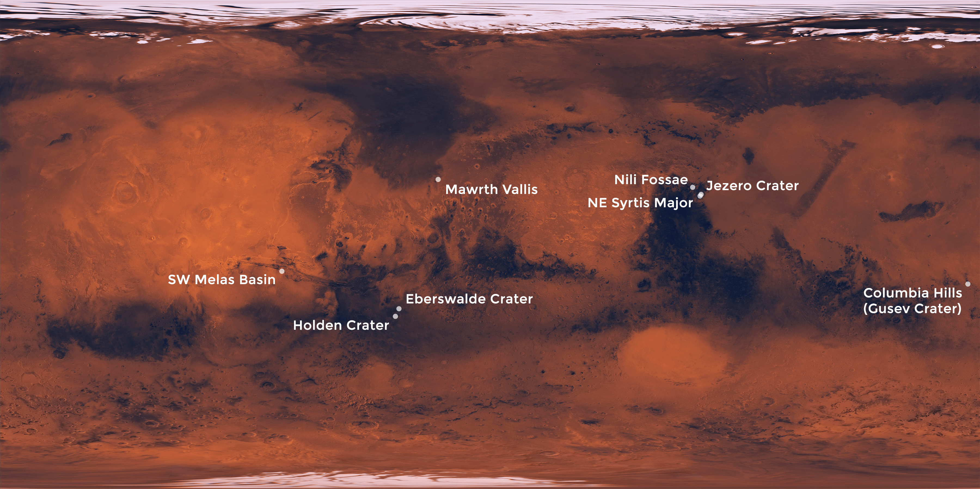

INDIAN INSTITUTE OF TECHNOLOGY KANPUR
The Mars Astrobiology, Resource, and Science Explorers (MARSE)
Mission Concept
ES661: PLANETARY REMOTE SENSING
SHEFALI KURIL
231230013
MTECH 1ST YEAR

Slide 2
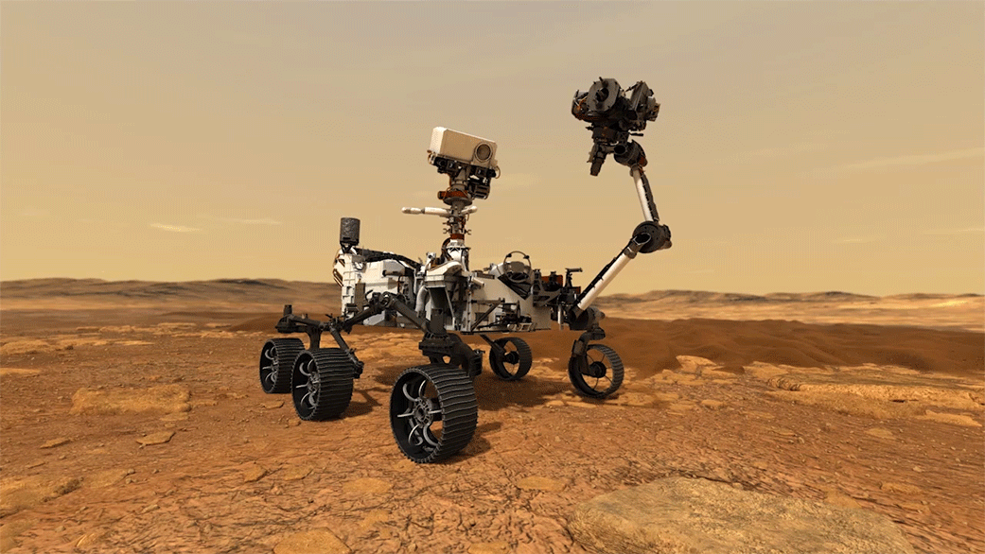
CONTENT
Introduction
Proposed landing sites for the four MARSE rovers
Implementation
Unveiling Mars’ Secrets: El Tatio as a window into the Red Planet’s Past
Unveiling Mars’ Water History: The Story of Chloride Deposits
Martian Ice: A Glimpse beneath the Surface
References

Slide 3
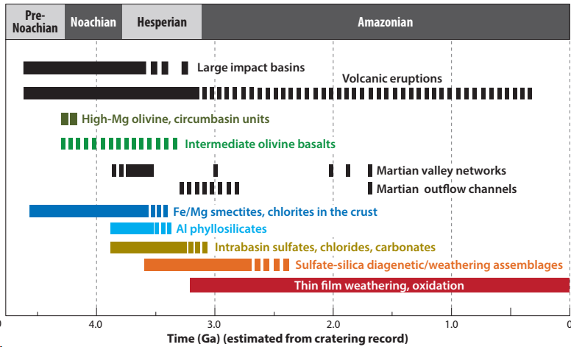
INTRODUCTION
Fig 1:Timeline of the major processes affecting the
mineralogic composition of Mars and the ages of
large-scale compositional units (Ehlmann et.al. 2014)
NASA's Mars Exploration Program uncovered geological
diversity and potential habitable conditions.
Mars' Varied Rocks: mainly basalt, but variations in minerals like plagioclase, pyroxene, and olivine.
Special Rocks in Craters: Large craters →unique rocks, including olivine→ they dug deep into Mars’ surface.
Clues from Ancient Rocks: Older rocks →specific types of olivine→ insights into past geological processes.
Signs of Past Water: Clay minerals → ancient aqueous environment + Evidence of ancient lakes and sediment layers + minerals formed from groundwater.
Objectives of MARSE Mission:
Determine whether the opaline silica outcrops in the Columbia Hills contain robust biosignatures.
Determine the physical and chemical state of mid-latitude ice deposits.
Determine the formation mechanism for the extensive clay deposits at Mawrth Vallis.
Determine the habitability of chloride-forming environments.
Longo et. al 2024

Slide 4
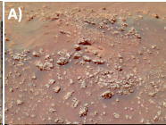
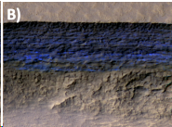
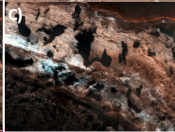
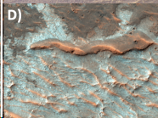
Proposed landing sites for the four MARSE rovers
(A) Nodular-digitate silica deposits with potential biosignatures in the Columbia Hills
MER spirit rover: Formations resemble hot spring sinter deposits OR Potential bio mediated microstromatolites.
MARSE: can Detect stromatolitic textures
B) Icerich mid-latitude scarps
Likely part of mid-latitude ice sheet.
MARSE: probe the climate record preserved by these scarps and study layering at millimeter scales.
C) Layered phyllosilicates
Determine formation mechanism
Possible deposition methods:
Precipitation
Leaching
Aeolian transport
(D) Chloride salt flats Likely formed in shallow saline lakes Youngest hydrated mineral deposits on Mars Unknown pH and salinity of source fluids
GUSEV CRATER
MILANKOVIC CRATER
MAWRTH VALLIS
TERRA SIRENUM
Longo et. al 2024

Slide 5
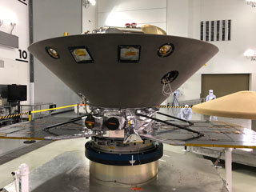
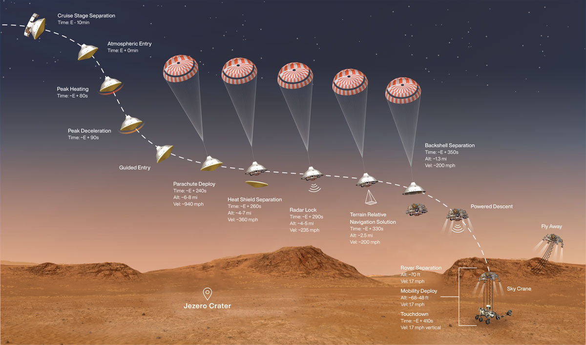
IMPLEMENTATION
MARSE Architecture
Simplified High Impact Energy Landing Device
(SHIELD) lander: It uses a low ballistic coefficient entry configuration, a low terminal velocity, and an impact attenuator to enable a survivable hard landing with an acceleration of less than 2,000 g.
The rovers will carry :
Raman spectrometer + hand lens imager for contact science+ panoramic camera + an infrared point spectrometer.
The rovers rely on preexisting orbiters to relay data + communication system will be a UHF antenna.
Each SHIELD lander →20 kg of payload.
Each SHIELD lander →Sojourner-class rover with a mass of 15 kg.
Four SHIELD landers launch on an EELV-class launch vehicle.
MARSE uses commercially available taxis in space to deliver rovers to separate landing sites on Mars with small course corrections along the way.
Fig 2: SHIELD-Prototype attached to drop tower-NASA Mars Exploration
Fig 3: The Entry, Descent, and Landing (EDL) sequence for a SHIELD lander.
Sojourner daily power
budget170 W-h.
MARSE will require
500+ W-h per Sol for
mobility requirement by
using more efficient solar
cells and/or deployable
solar arrays.
Want to reduce
the diameter of the
80-kilometer landing ellipse by 50% or more.
Longo et. al 2024

Slide 6
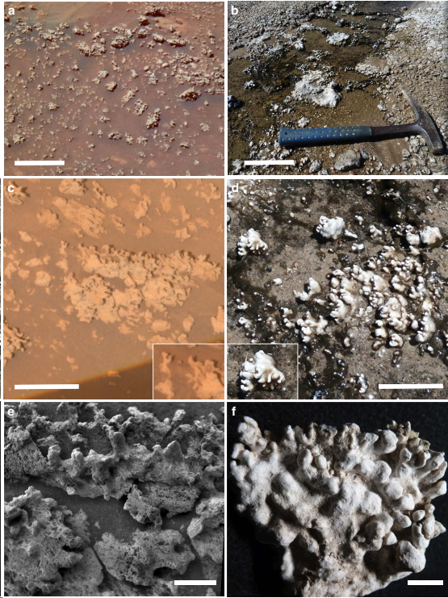
Unveiling Mars’ Secrets: El Tatio as a window into the Red Planet’s Past
Similarities:
Geology: Volcanic + evidence of past hot spring/geyser activity.
Minerals: Opaline silica deposits.
Structures: Nodular and digitate silica structures. El Tatio’s
structures are confirmed to be microbially influenced (microbialites).
Differences:
Environment: El Tatio = Mars' dry, high-UV conditions.
Preservation: Mechanism is unclear. Possible explanation: burial by
volcanic ash followed by exhumation through erosion.
Intriguing Feature:
The digitate structures at Home Plate resemble microstromatolites
(microbial structures) found at El Tatio. While the Martian structures’
origin is uncertain, they are worthy of further investigation.
Fig 4: Comparison of opaline silica structures adjacent to Home Plate with those of hot spring discharge channels at El Tatio(Chile).
Ruff et. al. 2016

Slide 7
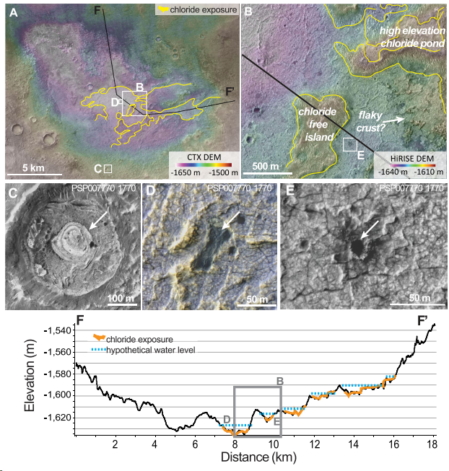
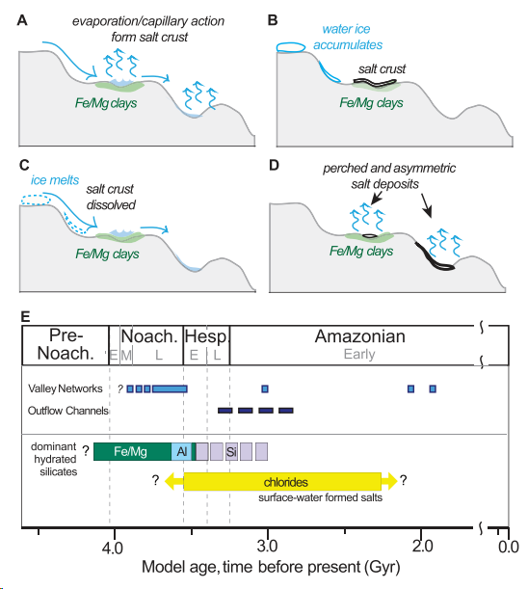
Unveiling Mars’ Water History: The Story of Chloride Deposits
Fig 5: Chloride deposit near Meridiani Planum
Fig 6: Schematic diagram for chloride formation
Leask et. al 2021

Slide 8
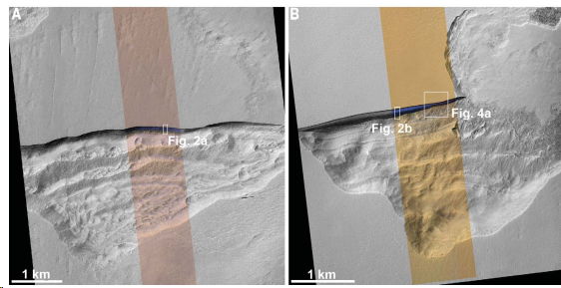
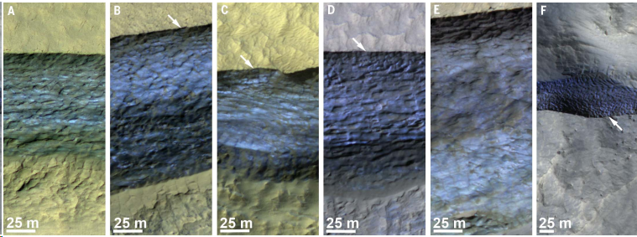
Martian Ice: A Glimpse beneath the Surface
Fig 7: Pits with scarps exposing ice
Fig 8: Enhanced-color transverse sections of icy scarps in late spring/ early summer. (A to F)
Thick Ice Deposits: >100 meters at mid-latitudes.
Shallow Access: 1-2 meters deep in some locations.
Snow Origin: likely originated as snowfall during high-obliquity period.
Compact & Layered: Over time, the deposits →compacted, fractured, and layered Ice.
Record of Climate: The vertical structure may hold clues about past Martian climate conditions.
Sublimation Retreat: Exposed ice faces retreat due to sublimation.
Potential Resource: The accessible ice deposits could be a valuable resource for future Martian
Exploration.
Dundas et. al 2018

Slide 9
REFERENCES
The Mars Astrobiology, Resource, and Science Explorers (MARSE) Mission Concept. A. Z. Longo1, Department of Earth, Marine, and Environmental Sciences, University of North Carolina at Chapel Hill, Chapel Hill, NC 27599 (azlongo@live.unc.edu).
Ehlmann B. L. and Edwards C. S.(2014) Annual Rev. Earth Planet. Sci., 42, 291-315.
Silica deposits on Mars with features resembling hot spring biosignatures at El Tatio in Chile Steven W. Ruff1 & Jack D. Farmer.
Evidence for Deposition of Chloride on Mars From SmallVolume Surface Water Events Into the Late Hesperian-Early Amazonian Ellen K. Leask1,2 and Bethany L. Ehlmann1.
Exposed subsurface ice sheets in the Martian mid-latitudes Colin M. Dundas,1* Ali M. Bramson,2 Lujendra Ojha,3 James J. Wray,4 Michael T. Mellon,5 Shane Byrne,2 Alfred S. McEwen,2 Nathaniel E. Putzig,6 Donna Viola,2 Sarah Sutton,2 Erin Clark,2 John W. Holt7.

Slide 10


THANK YOU

